Slide 1

Grocery And More

Slide 2
Presented By
Unnati Kasar
Shivani Tandulwar
Priyanka Sonawane
Lavanya Anabattula
Srivijaya Namburi
Sonal Nikumbhe

Slide 3
Introduction
The Problem Statement
An online grocery chain 'Grocery & More' has multiple stores in different cities in India. Customers can either buy directly from the store or order their products online. 'Grocery & More' procures the products from different vendors.
'Grocery & More' wants to analyze their profit & margins for each store from data available for the last 3 years. They also want to analyze customer buying trends. To get that insight, 'Grocery & More' wants to create a Data Warehouse solution on which they can do data analytics.

Slide 4
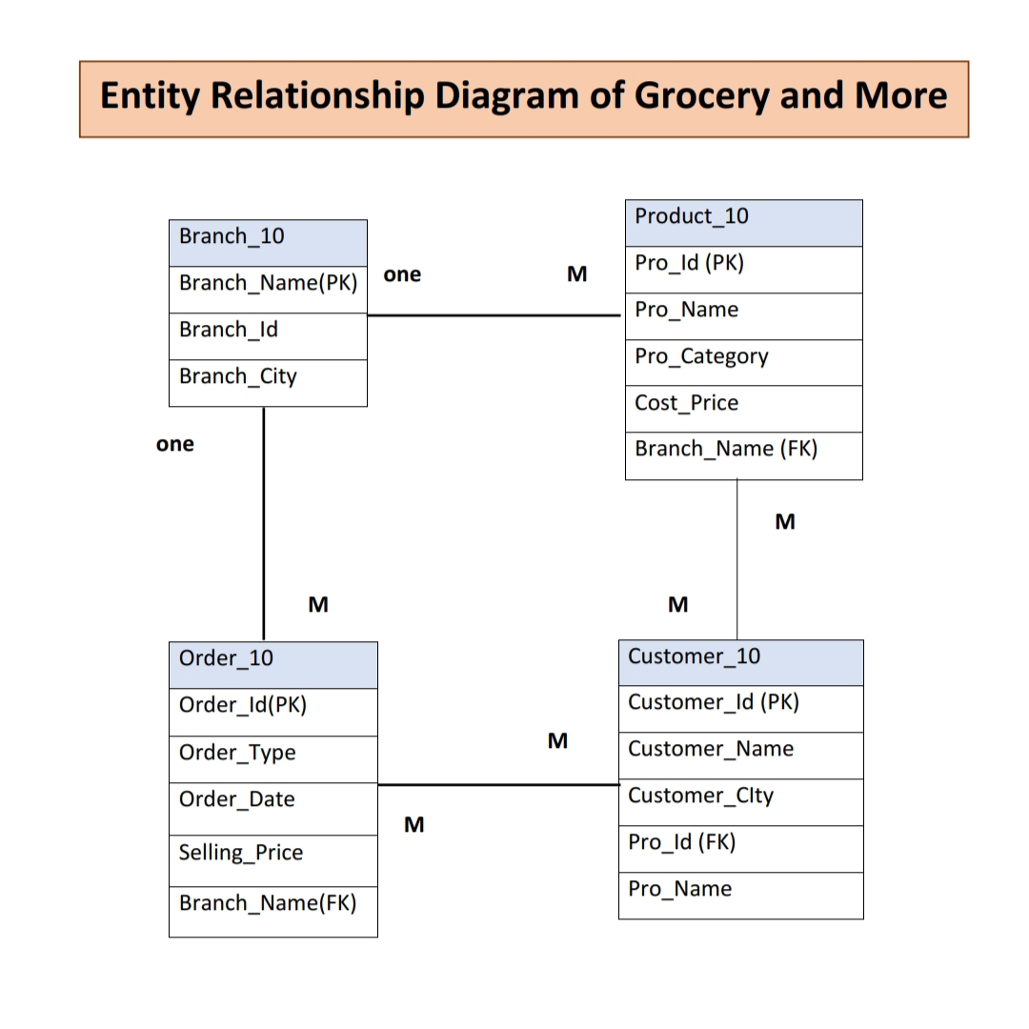
Entity Relationship Diagram

Slide 5
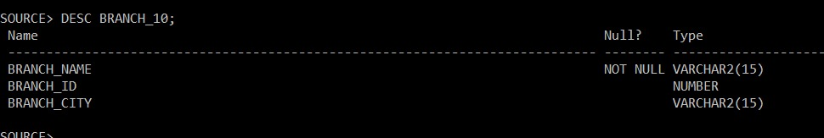
Table Description
Branch table
CREATE TABLE BRANCH_10 (BRACH_NAME VARCHAR2(15) PRIMARY KEY, BRACH_ID NUMBER,BRANCH_CITY VARCHAR2(15));

Slide 6
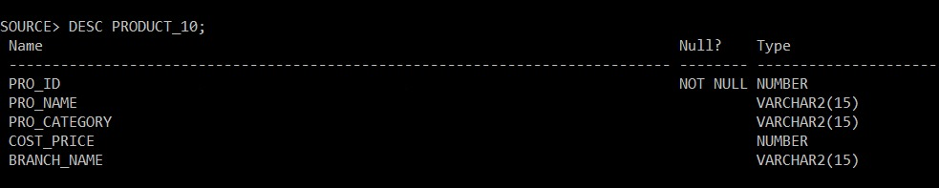
Product Table
CREATE TABLE PRODUCT_10(PRO_ID NUMBER PRIMARY KEY ,PRO_NAME VARCHAR2(15),PRO_CATEGORY VARCHAR2(15),COST_PRICE NUMBER BRANCH_NAME REFRENCES BRANCH_10 (BRANCH_NAME));

Slide 7
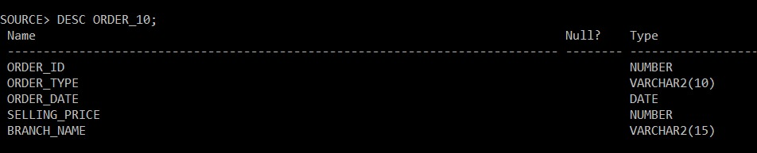
Order Table
CREATE TABLE ORDER_10 (ORDER_ID NUMBER,ORDER_TYPE VARCHAR2(10),ORDER_DATE DATE,SELLING_PRICE NUMBER,BRANCH_NAME REFRENCES BRACH_10(BRANCH_NAME));

Slide 8
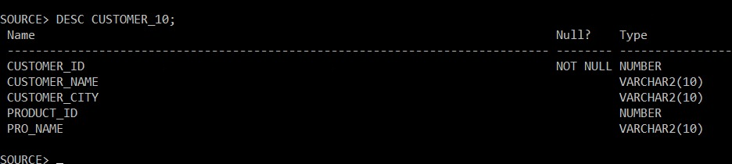
Customer Table
CREATE TABLE CUSTOMER _10(CUSTOMER_ID NUMBER PRIMARY KEY,CUSTOMER_NAME VARCHAR2(10),CUSTOMER_CITY VARCHAR2(10),PRODUCT_ID REFRENCES PRODUCT_10(PRO_ID),PRO_NAME VARCHAR2(10));

Slide 9
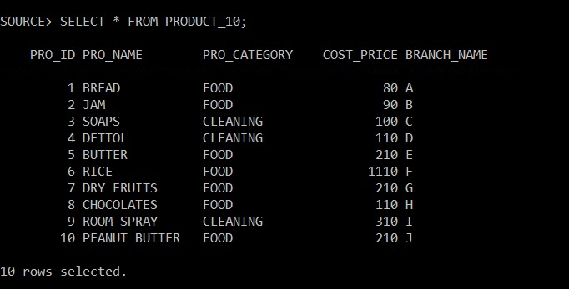
Sample Output
Data in Product Table

Slide 10
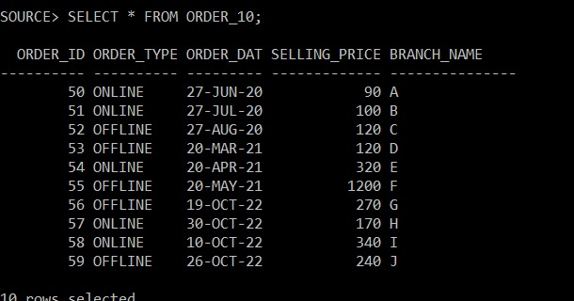
Data in Order Table

Slide 11
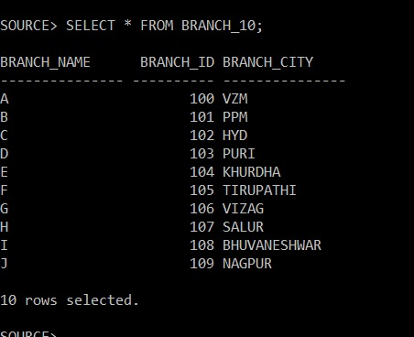
Data in Branch Table

Slide 12
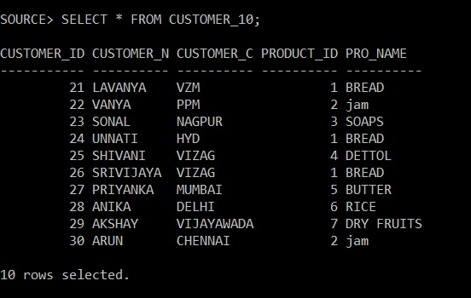
Data in Customer Table

Slide 13
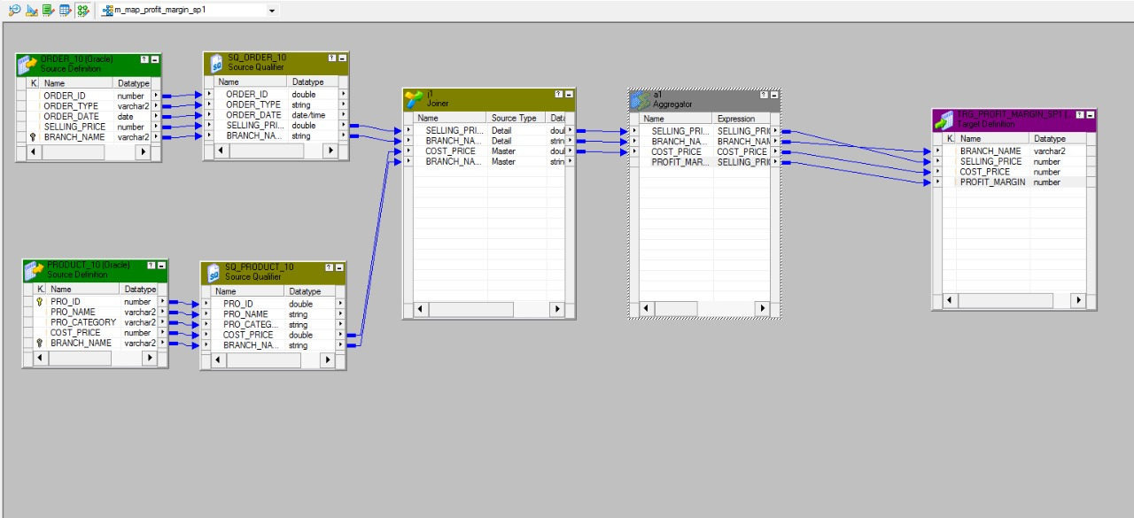
Informatica ETL Code
Profit and Margin Mapping

Slide 14
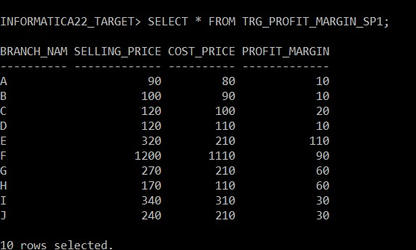
Sample data

Slide 15
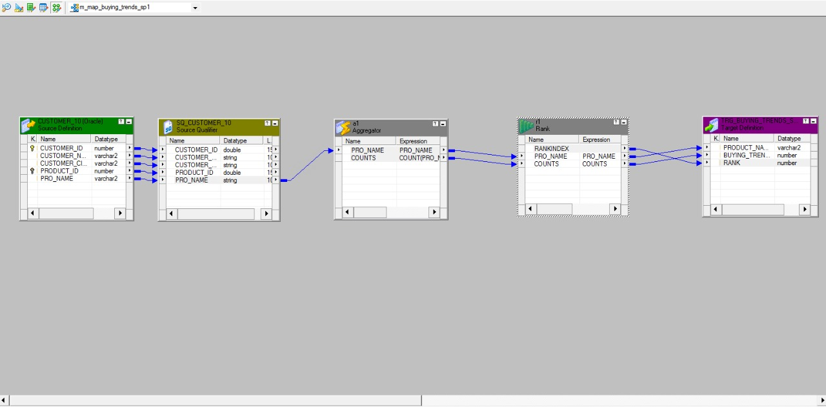
Buying Trends Mapping

Slide 16
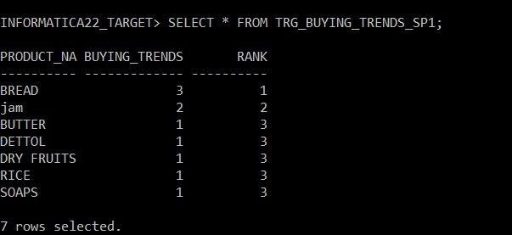
Sample Data

Slide 17
Unit Testing #T1
Test Case Purpose: Validate workflow – wf_s_m_map_profit_margin_sp1
Input Value/Test Data: Sources and targets are available and connected
Sources : ORDER_10, PRODUCT_10 Mappings : m_map_profit_margin_sp1 Targets : TRG_ PROFIT_MARGIN_SP1 Session : s_m_map_profit_margin_sp1
Transformations:
Aggregator
Joiner

Slide 18
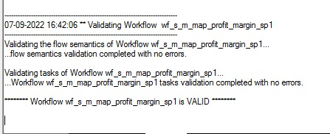
Expected Results: Message in workflow manager status bar: “Workflow wf_s_m_map_profit_margin_sp1 is valid “
Actual Results: Message in workflow manager status bar: “Workflow wf_s_m_map_profit_margin_sp1 is valid
Remarks: Pass

Slide 19
Test Case #T2
Test Case Purpose: Validate workflow wf_s_m_map_buying_trends_sp1
Input Value/Test Data: Sources and targets are available and connected
Sources : CUSTOMER_10
Mappings: m_map_buying_trends_sp1 Targets : TRG_BUYING_TRENDS_SP1
Session : s_m_map_buying_trends_sp1
Transformations:
Aggregator
Rank

Slide 20
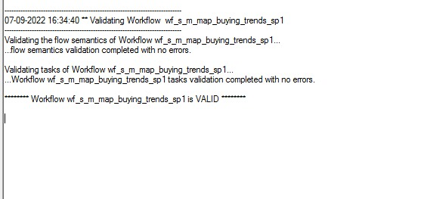
Expected Results: Message in workflow manager status bar: “Workflow wf_s_m_map_buying_trends_sp1 is valid “
Actual Results: Message in workflow manager status bar: “Workflow wf_s_m_map_buying_trends_sp1 is valid “
Remarks: Pass

Slide 21
Integration Testing #T1
Test Case ID: T1
Test Case Purpose: Validate Mapping,m_map_profit_margin_sp1, Validate Workflow, wf_m_map_profit_margin_sp1
Input Value/Test Data:
Sources : ORDER_10, PRODUCT_10
Target : TRG_PROFIT_MARGIN_SP1
Transformation:
Joiner
Aggregator

Slide 22
Expected Result:
Check Mapping => Mapping is validate
Go to workflow => Message in workflow manager status bar: “Workflow wf_s_m_map_profit_margin_sp1 is valid”
Actual Result: Message in workflow manager status bar: ”Workflow wf_s_map_profit_margin_sp1 is valid”
Remarks : Pass

Slide 23
Test Case #T2
Test Case Purpose: Validate Mapping m_map_buying_trends_sp1, Validate Workflow wf_s_ m_map_buying_trends_sp1
Input Value/Test Data: Connect Sources and Target tables
Source Table : CUSTOMER_10
Target Table : TRG_BUYING_TRENDS_SP1
Transformation:
Aggregator
Rank

Slide 24
Expected Result:
Check Mapping=> Mapping is validate
Go to workflow > Message in workflow manager status bar: “Workflow
wf_s_ m_map_buying_trends_sp1 is valid”
Actual Result: Message in workflow manager status bar : ”Workflow
wf_s_ m_map_buying_trends_sp1 is valid”
Remarks : Pass

Slide 25
Regression Testing #T1
Test Case Purpose: Validate Mapping m_map_profit_margin_sp1, Validate Workflow, wf_m_map_profit_margin_sp1
Input Value/Test Data:
Sources: ORDER_10, PRODUCT_10
Target : TRG_PROFIT_MARGIN_SP1
Transformation:
Joiner
Aggregator

Slide 26
Expected Result:
1. Check Mapping => Mapping is validate
2. Go to workflow => Message in workflow manager status bar: “Workflow wf_s_m_map_profit_margin_sp1 is valid”
Actual Result:Message in workflow manager status bar:”Workflow wf_ s_map_profit_margin_sp1 is valid”
Remarks: Pass

Slide 27
Test Case #T2
Test Case Purpose: Validate Mapping m_map_buying_trends_sp1, Validate Workflow
wf_s_ m_map_buying_trends_sp1
Input Value/Test Data: Connect Sources and Target tables
Source Table : CUSTOMER_10
Target Table : TRG_BUYING_TRENDS_SP1
Transformation:
Aggregator
Rank

Slide 28
Expected Result:
1. Check Mapping=> Mapping is validate
2. Go to workflow > Message in workflow manager status bar: “Workflow
Wf_s_ m_map_buying_trends_sp1 is valid”
Actual Result: Message in workflow manager status bar : ”Workflow
Wf_s_ m_map_buying_trends_sp1 is valid”
Remarks: Pass

Slide 29

THANK YOU

